Slide 1


Predicting Baseball Game Outcomes
By: Tom Dobbs

Slide 2

Project Overview
GOAL: Predict baseball game outcomes
WHY:
I love baseball [even though it’s boring] and they have a LOT of data
The type of data being logged is very detailed
Data collection & manipulation is complicated
If my model is good enough, I’ll be super rich
FEATURES:
Starting Pitchers – Trending pitcher performance
Starting Batters (Lineup) – Trending performance of players aggregated to form “lineups”
Teams – Trending Team Performance
TARGET: Home win

Slide 3
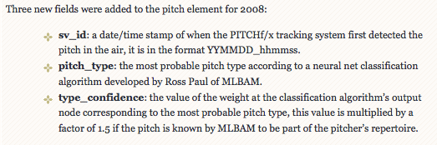

Data History
Major League Baseball has been tracking detailed pitch by pitch stats since 2006 with the PITCHf/x[1] camera system. There are roughly 30 data points logged for every pitch; data points that go as far as describing the exact pitch location, the velocity of the ball from the pitcher’s hand, and the break angle of the ball from the pitcher’s hand to the plate.
Cool Fact: MLB uses Machine Learning to Classify the pitch_type!!!!!
[1] PITCHf/x, created and maintained by Sportvision, is a system that tracks the speeds and trajectories of pitched baseballs. This system, which made its debut in the 2006 MLB playoffs, is installed in every MLB stadium.

Slide 4
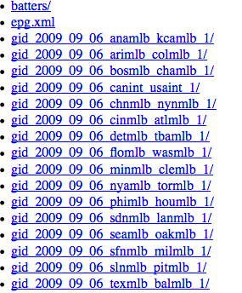
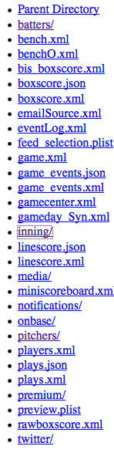
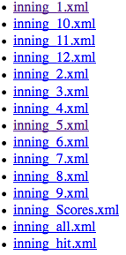


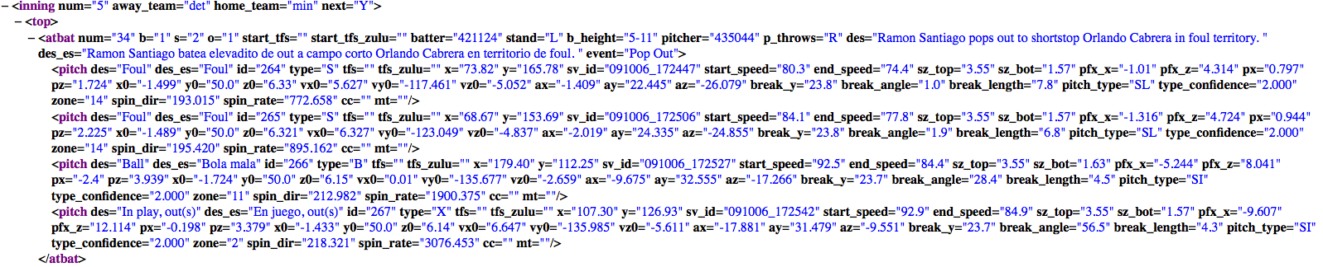
Data Format
Baseball data is located on the MLB.com website and it’s NOT pretty.
There are a web of URLs to iterate through and at the end of the trail, the data is stored in XML format.

Slide 5

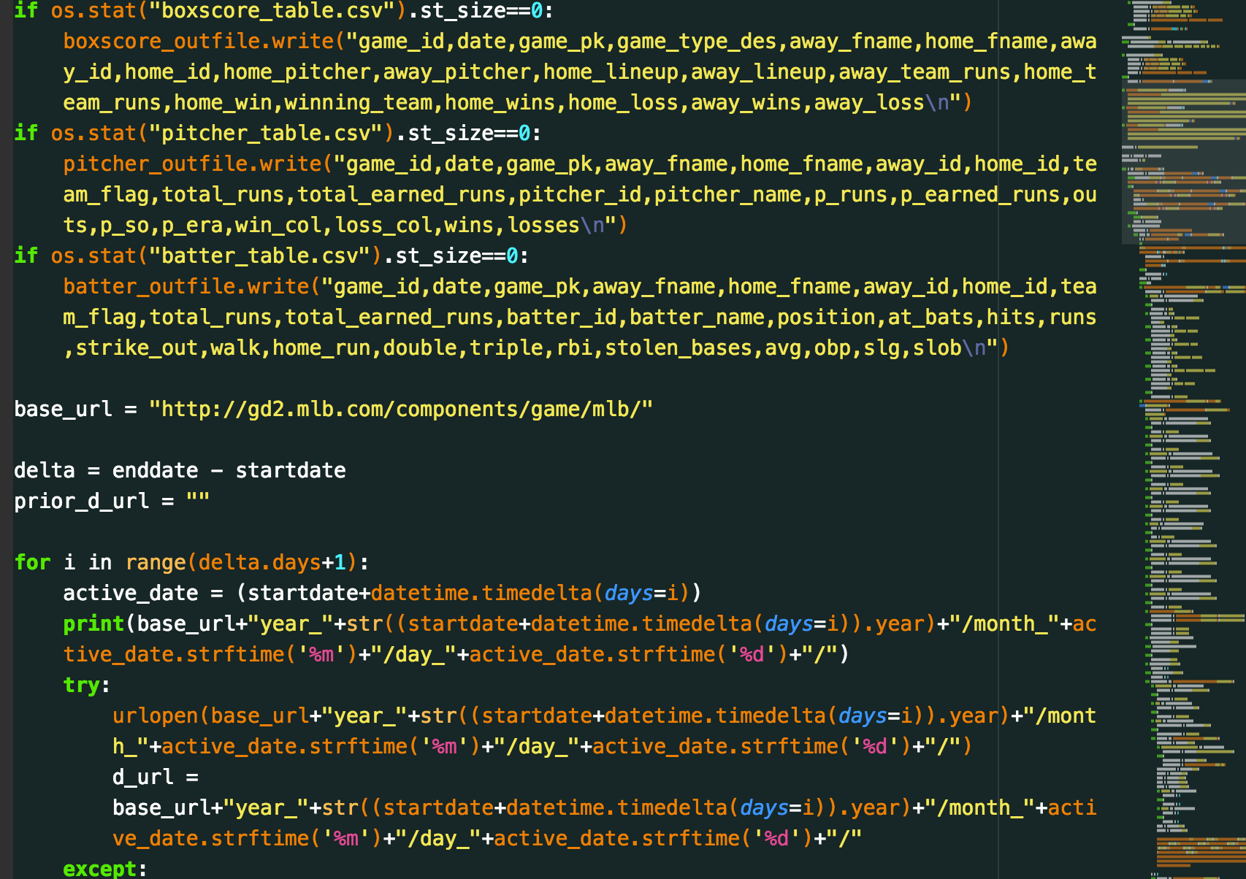
Data Scraping
Luckily we live in an open source world! Turns out someone put together a Python parser to pull PITCHf/x data on September 2015! – But it was totally not what I was looking for ☹☹….so I decided to rebuild! And 6 to infinity hours later I rebuilt it to scrape the exact information I wanted into 3 tables.
10 Years of Data and 30,000 games!!
Pitcher performance
Batter performance
Boxscores
1am & validated the scraper is working properly
Notes:
Very long process
Lots of trial and error – make sure to do in small sizes

Slide 6

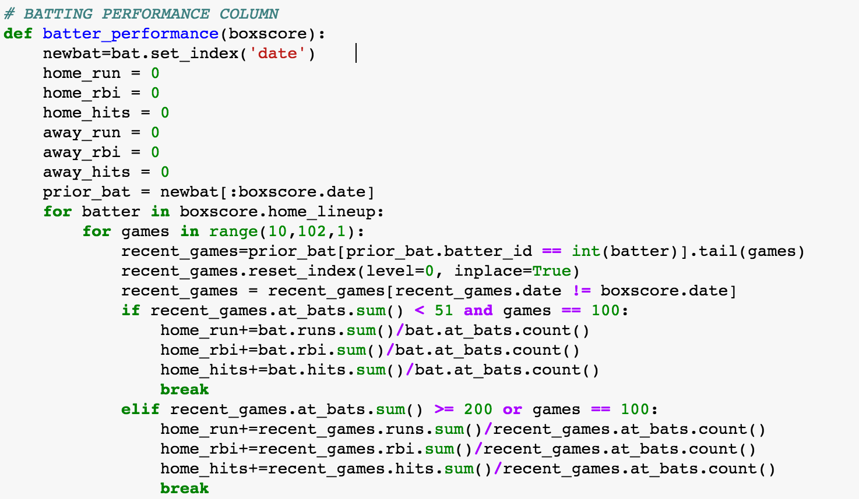

Data Wrangling
The primary manipulation I applied was creating 14 Performance Related Columns based off of the starting pitchers and starting lineups for that day:
Avg. runs given up by pitcher
Avg. earned runs given up by pitcher
Aggregated avg. runs per game
Aggregated avg. rbi’s per game
Aggregated avg. hits per game
Team’s win prob home/away
Team’s avg. runs home/away
Notes:
I learned a lot of debugging best practices…
Review data format

Slide 7


What ML Model wins???
Bad Models
Trees
This model immediately split on the home team winning (roughly 95%+ of predictions were that the home team would win)
Good Models
Support Vector Machines (SVM) & Logistic Regression
Final Model
Logistic Regression
Why LogReg?
- It’s easy to explain and I can see what % certainty the model is that the home team will win
LogReg

Slide 8
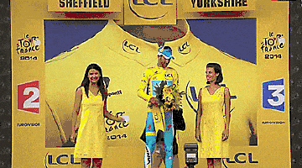

RESULTS!
Logistic Regression Results
56% Accuracy!!!!!!!!!!!!!!!!!
Is that good?
Not really.
If you guessed the home team would win, you’d be right 54.3% of the time.
I’ve also heard other people have been able to get 60%+ accuracy
What could be better?
A lot.
There’s a lot of feature engineering I could have done, but was very occupied w/ getting the data together
I should have gone to more office hours!

Slide 9


NEXT STEPZZZZZ
Start Scraping Baseball Odds from Gambling Sites
Put together SQLite database with gambling odds + my predictions
Use unsupervised learning to build pitcher/batter profiles
Create Dashboard (Flask all day) so randos can input starting pitchers + starting lineups & get their own predictions – and make sure it looks cool
Try out additional models, create new features, and regularize features

